Slide 1
Management and Organization of Online Classes: Challenges and Opportunities
By
Dr. Sheikh Abu Reza
Former Director (P&D), DTE &
CBT&A Trainer

Slide 2
Management and Organization of Online Classes: Challenges and Opportunities
The spread of the infective disease caused by the COVID-19 has caused an international health pandemic that has had challenging ramifications socially and economically and on education as one of the significant areas disrupted. However, this disruption could be the beginning of a surprising innovation because the institutions, including educational ones, responded to the travel bans and home quarantines by shifting to online interaction. Although major issues arise from the crisis that caused the shift, users worldwide wonder whether COVID-19 could act as a catalyst for the online progress in educational procedures and accelerate the use of the latest technology to the point where the future becomes the present. The coronavirus pandemic has revolutionized global education through the unprecedented introduction of new solutions, tools, and applications. According to UNESCO’s statistics, the closure of universities worldwide to contain the COVID-19 pandemic has affected 91% of the student population.

Slide 3
Main Challenges & Opportunities of organizational behavior are:
Improving peoples skills.
Improving quality and productivity
Total quality management (TQM)
Managing workforce diversity

Slide 4
Challenges & Opportunities
Responding to collaboration
Empowering employees and clients
Coping with temporariness
Stimulating innovation and change
Emerges of e-organization and e-learning
Improving ethical behavior
Improving clients services
Helping employees balance work-life conflicts

Slide 5
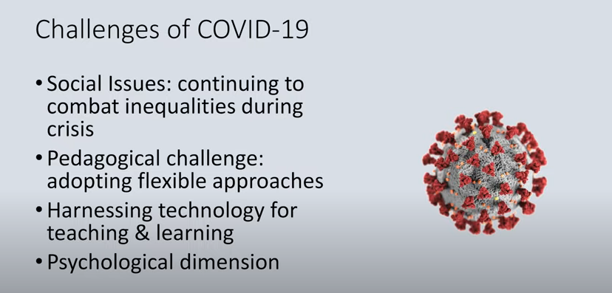
Challenges

Slide 6
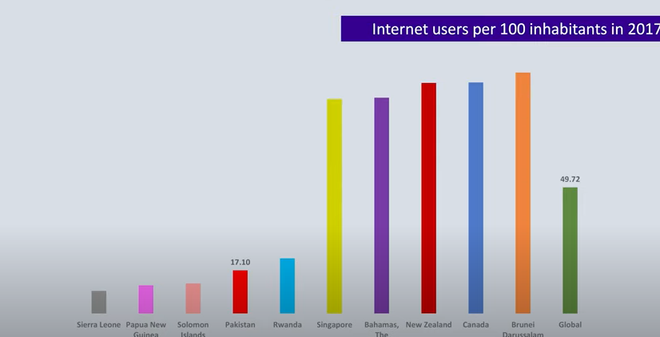
Internet users per 100 inhabitants in 2017

Slide 7
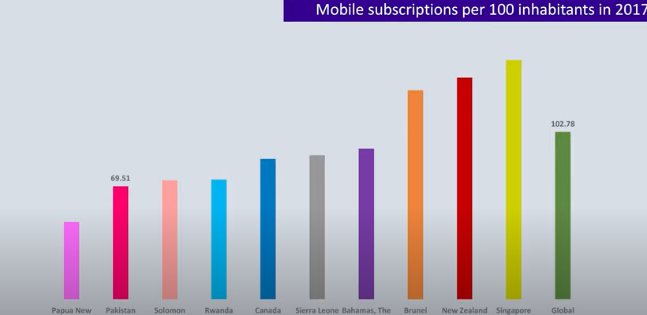
Mobile subscriptions

Slide 8

Boat schools in Bangladesh

Slide 9
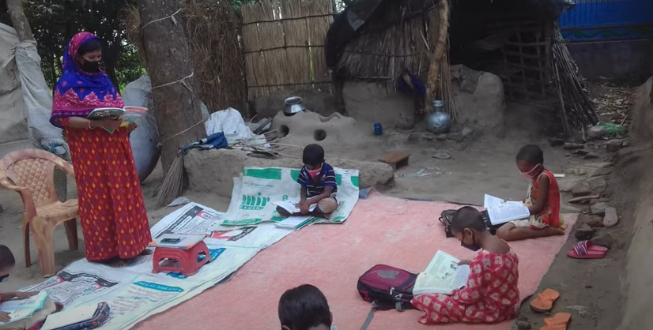
Social distance

Slide 10
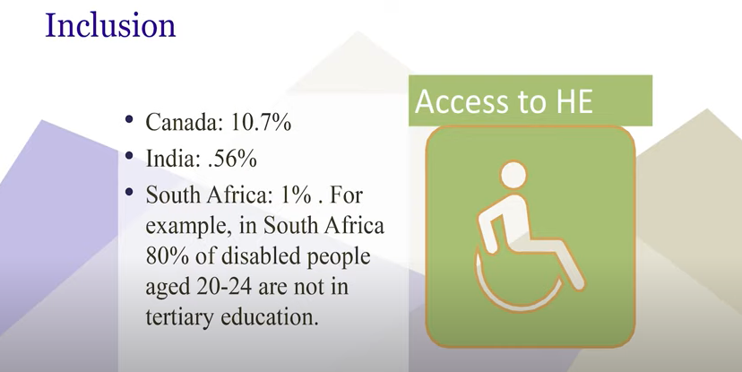
PWD

Slide 11
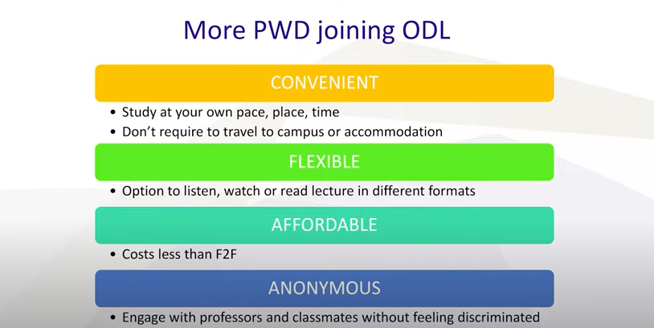
More PWD joining ODL

Slide 12
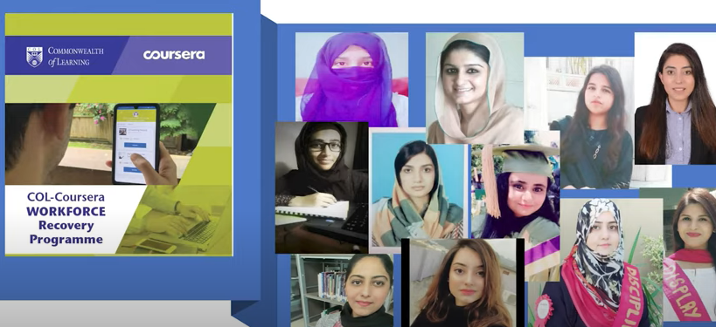
Workforce Recovery Programme

Slide 13
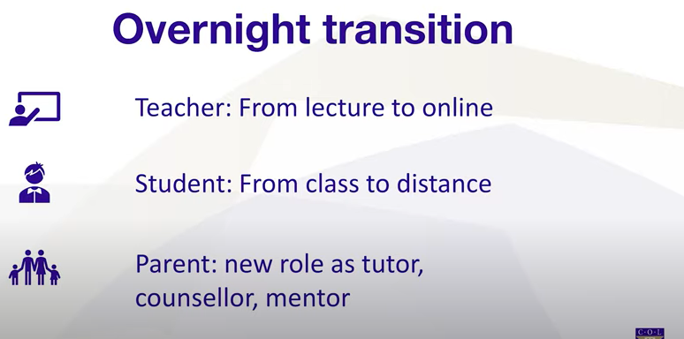
Pedagogical Challenge

Slide 14
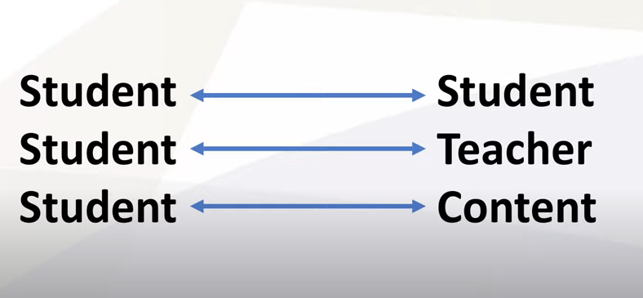
3 Type Content

Slide 15
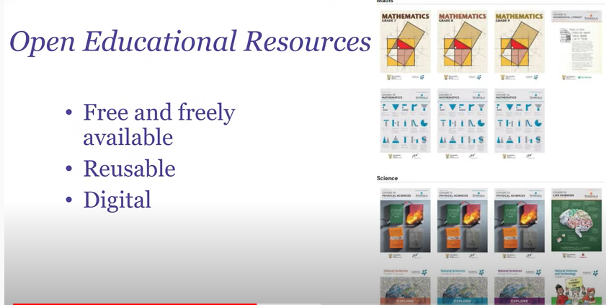
Quality Contents

Slide 16
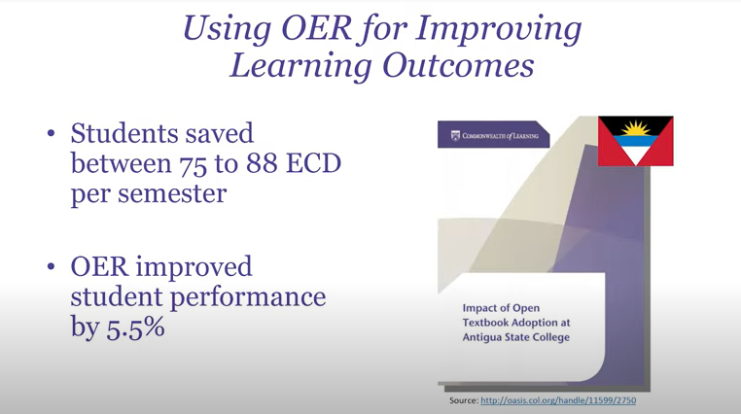
OER

Slide 17
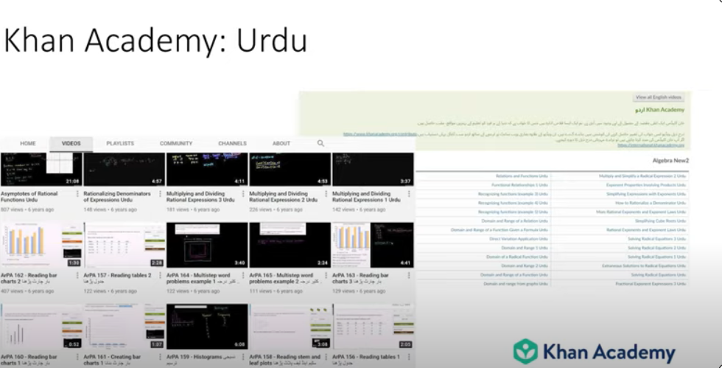
Khan Academy USA

Slide 18
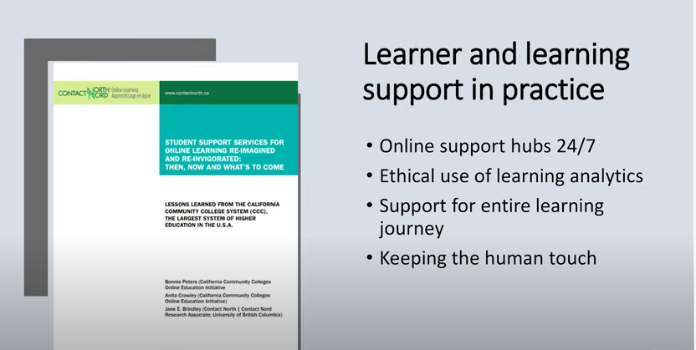
Learner & Learning Support

Slide 19
IIST Mirpur-10, Dhaka-1216
Ideal Institute of Science & Technology (IIST)

Slide 20
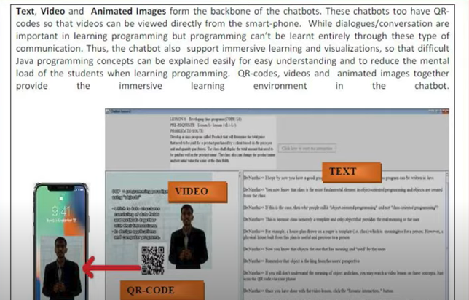
Jackpot Malaysia

Slide 21
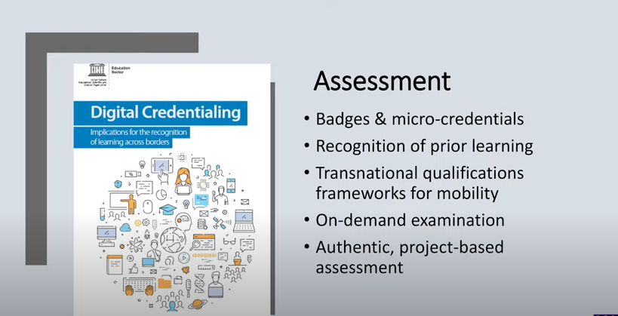
Assessment

Slide 22

Blended Learning

Slide 23
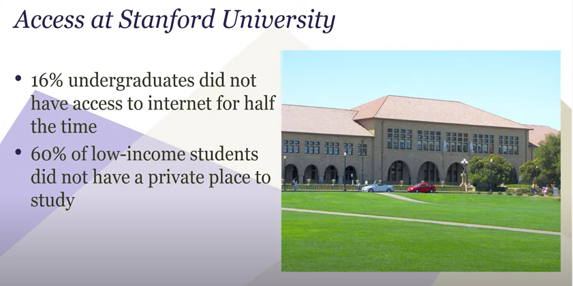
Access

Slide 24
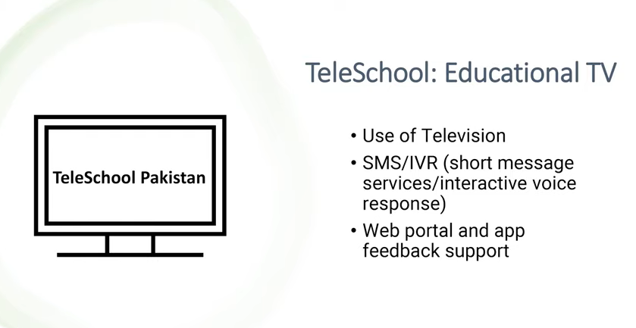
Tele School TV

Slide 25
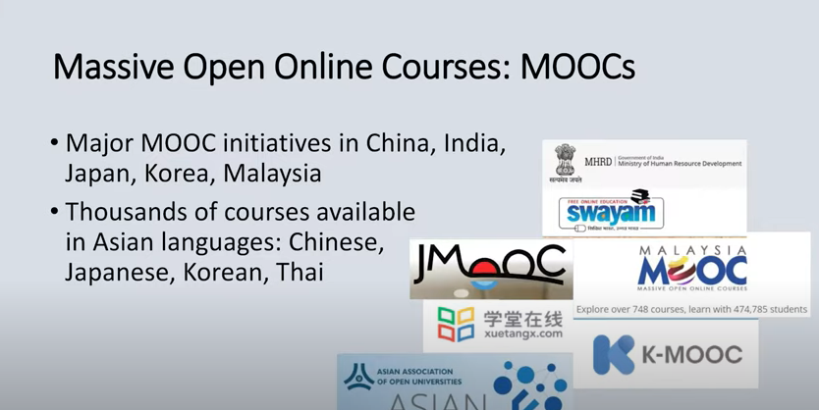
Online Courses

Slide 26

Mobile

Slide 27
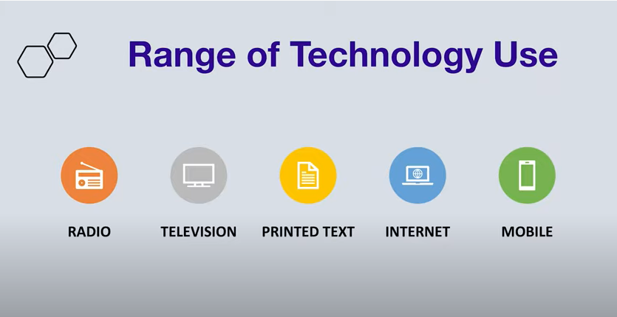
Range of Technology uses

Slide 28
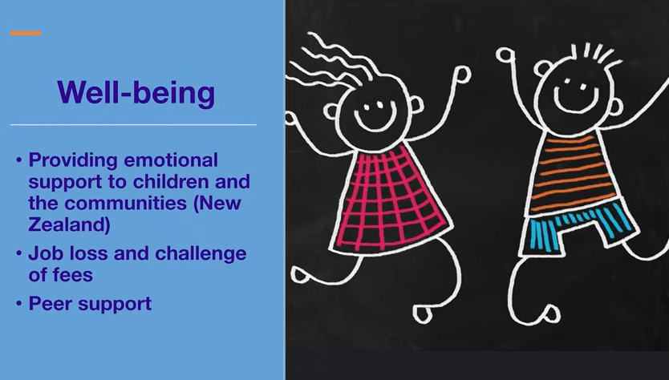
Well-being

Slide 29

Online Safety

Slide 30
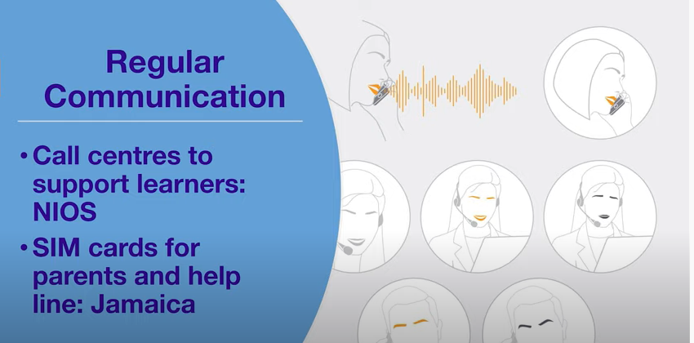
Regular Communication

Slide 31

3 C

Slide 32

Connectivity

Slide 33
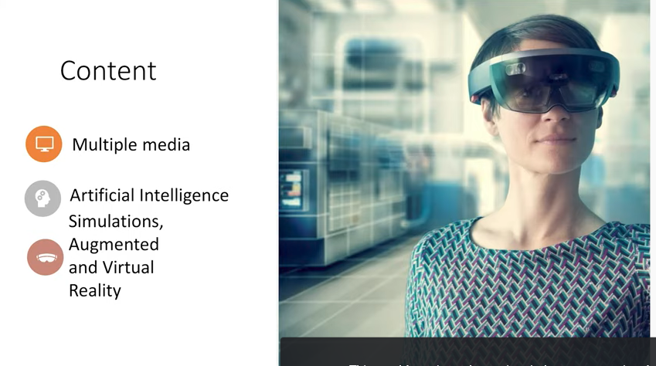
Mindset

Slide 34

Multiple Media (Web Development Level-4)

Slide 35
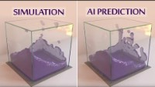
Artificial Intelligence Simulation

Slide 36
How Augmented Reality (AR) Is Transforming The Education Industry
The AR experience is thriving as a significant trend, and it is estimated that by 2023 there will be 2.4 billion Augmented Reality mobile users worldwide. However, there were only 200 million users in 2015. It is an excellent influx in numbers that can't be ignored. However, my interest in this article is looming around the usage of Augmented Reality in education and eLearning applications. Many of us are only aware of Augmented Reality being used in mobile games like Pokémon Go and social media platforms like Snapchat. However, education is another significant space where this technology can blow up the candles.

Slide 37
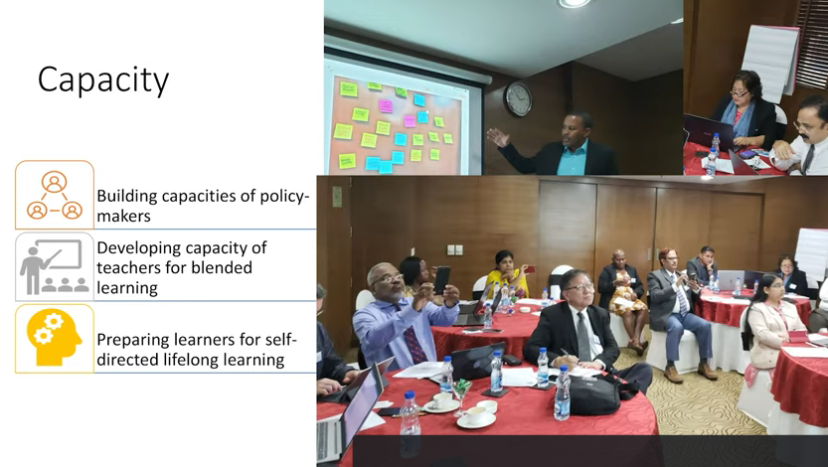
Capacity

Slide 38
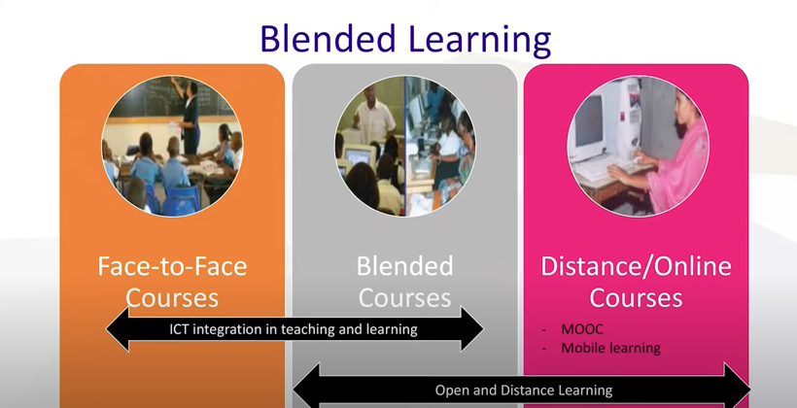
Blended Learning

Slide 39
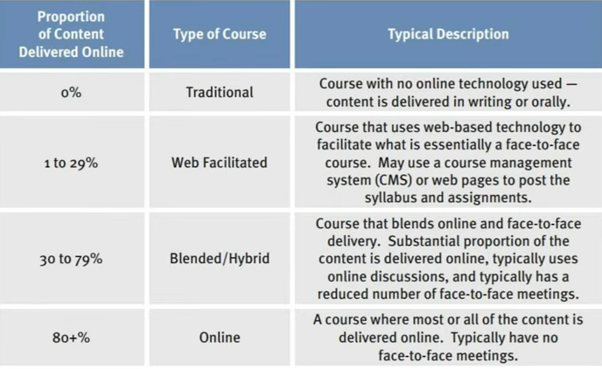
Options

Slide 40

Best Wishes to All

